Slide 1
Mr Miyagi Taught me binary

Slide 2
What is binary?
Binary describes a numbering scheme in which there are only two possible values for each digit: 0 and 1.
On or off
16 | 8 | 4 | 2 | 1 | total
0 | 0 | 0 | 1 | 1 | 3
0 | 0 | 1 | 0 | 1 | 5
1 | 1 | 0 | 1 | 0 | 26

Slide 3
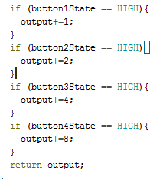
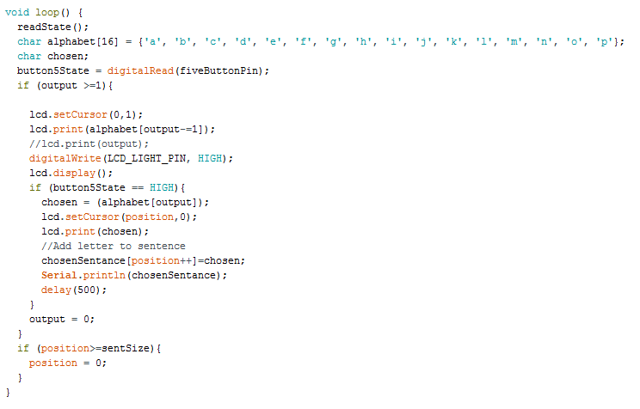

Slide 4
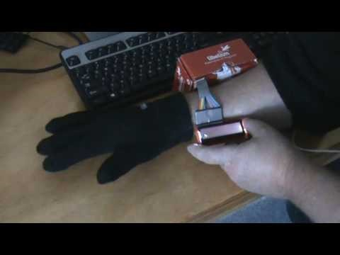

Slide 5
Possible implementations
Drive a car with no feet
Court Stenographer – People who write stuff in court
Gaming plug in
Texting while otherwise occupied (driving, working, under water, etc)
Not limited to alphabet – any item in the array can be used with a combination
Calculator
Over 1,000 combinations with 10 buttons

Slide 6
Questions??

